Slide 1
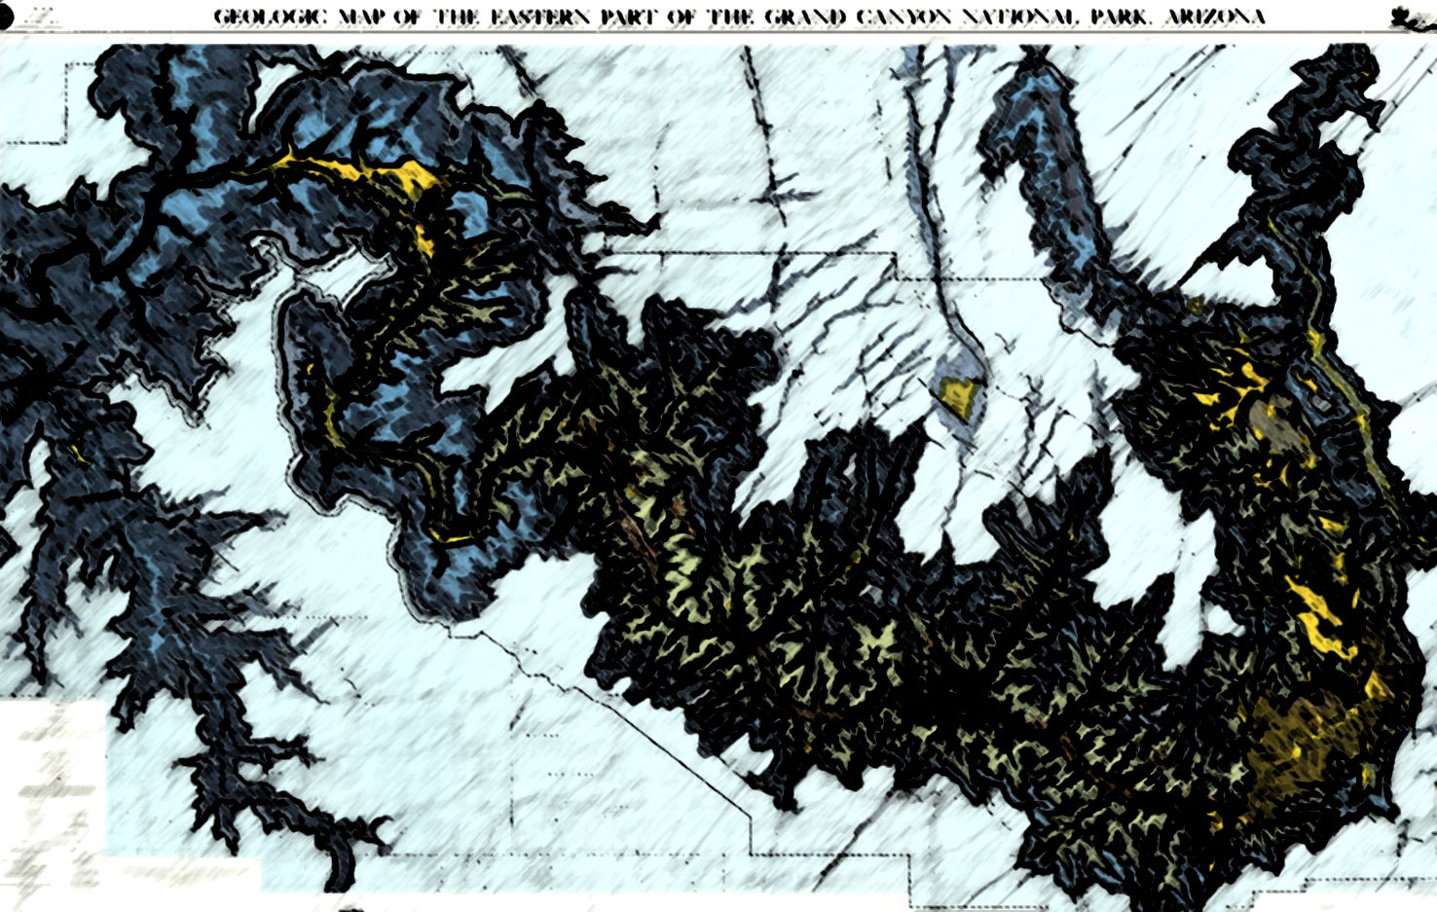
Lithologic heterogeneity in landscape evolution: Techniques in remote slope determination via ArcGIS
Courtney Starling
Kelin Whipple
Andrew Darling
2015-2016 Arizona Space Grant Symposium
April 16, 2016

Slide 2
Outline
Objective: Characterize lithologic heterogeneity
  Differences in rock strength leading to various rates of erosion.
Methods: Determining slopes of the units of the Grand Canyon
Investigate techniques of remote measurements of slope.
  Use ArcMAP, Google Earth, local pictures.

Slide 3
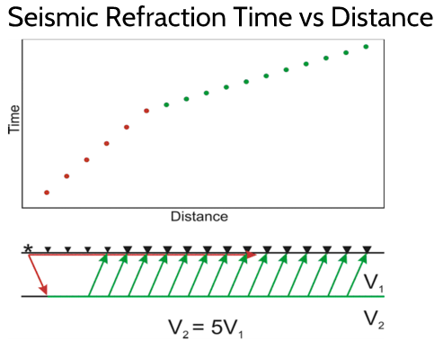
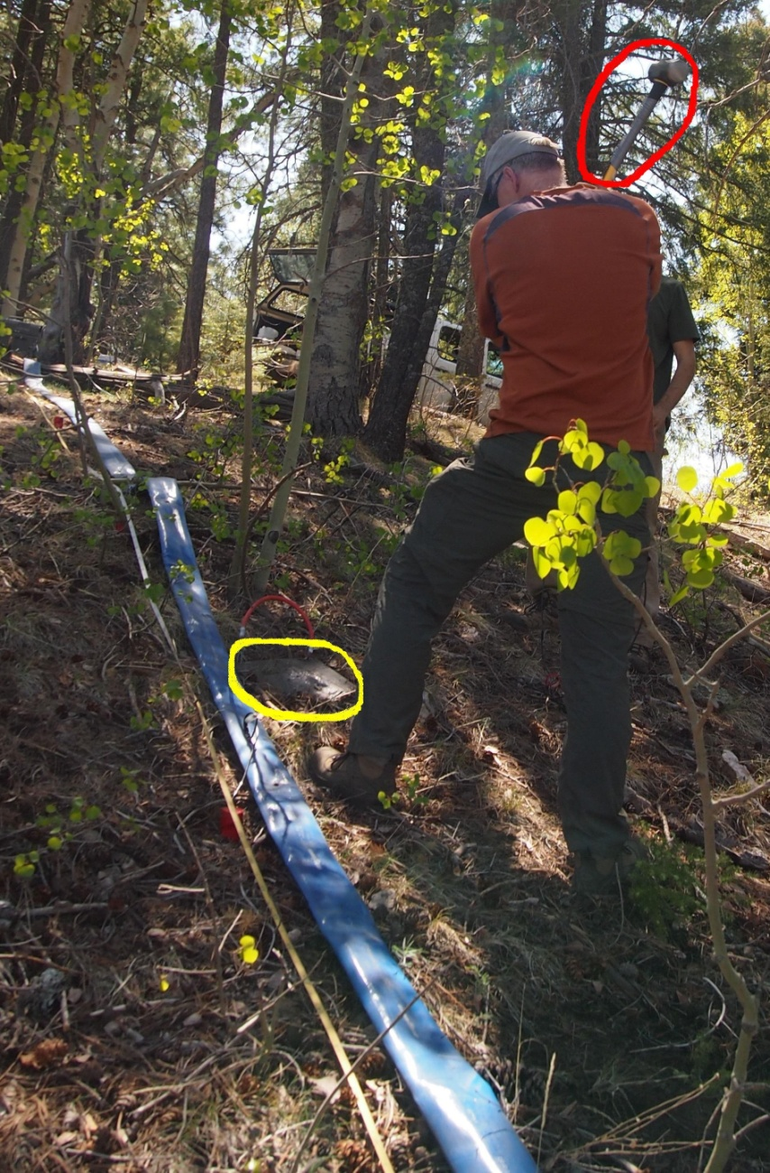
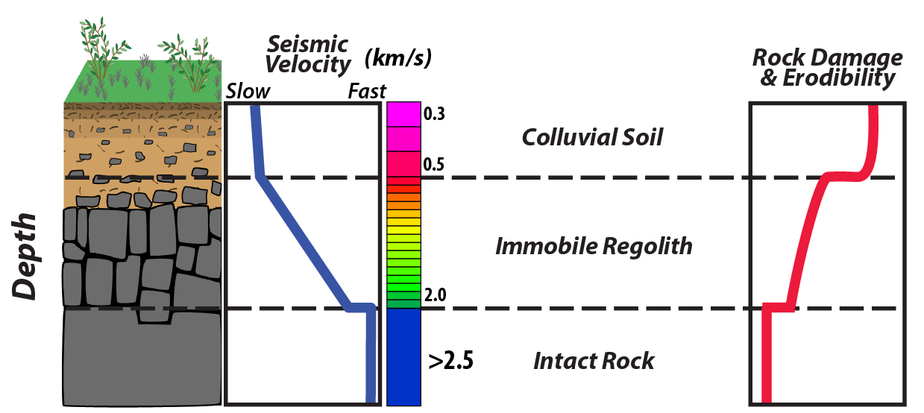
Prior Research
Seismic Hammer, plate and geophones.
Measure sub-surface P-wave velocity
Photo Courtesy of Marina
Bravo Foster, ASU
P-wave velocity shown to correlate with degree of fracturing and depth.
Depth increase, P-wave velocity increases
Figure courtesy of Brian Clarke

Slide 4
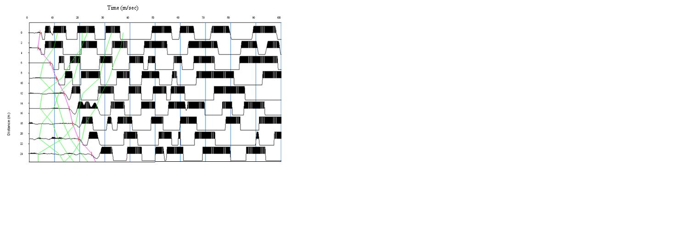
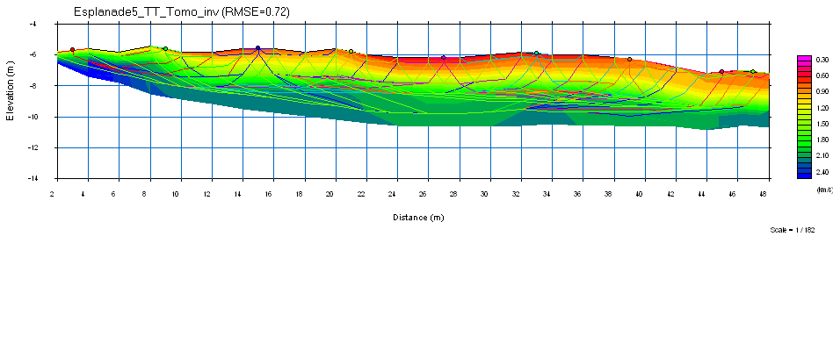
Time vs Distance for P-wave velocities– in Seisimager (right).
Tomography with ray lines showing velocity at depth (below).

Slide 5
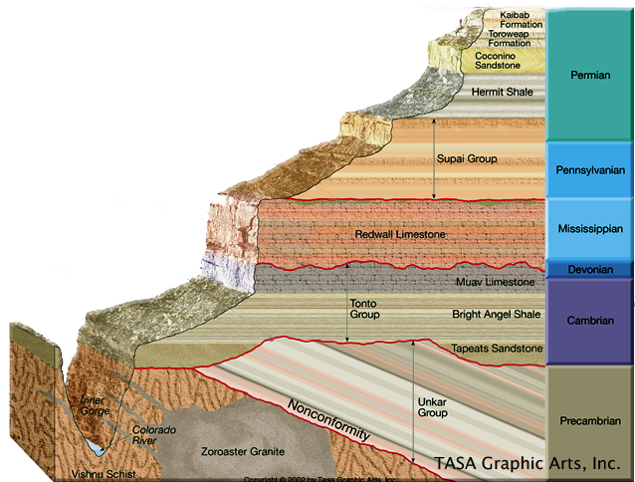
Slope & Lithology
Use slope angle to determine rock mass strength.
  Cliff-formers: high slope angle
    Red Wall Limestone
  Slope-former: low slope angle
    Bright Angle Shale
Courtesy of Alamo Impact Online

Slide 6
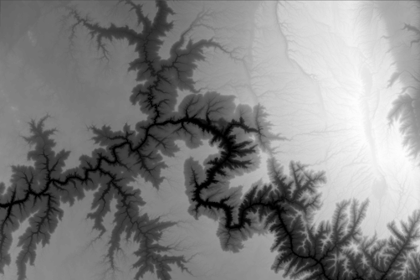
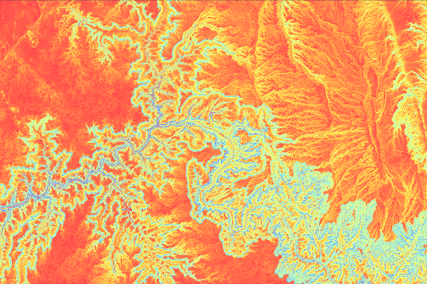
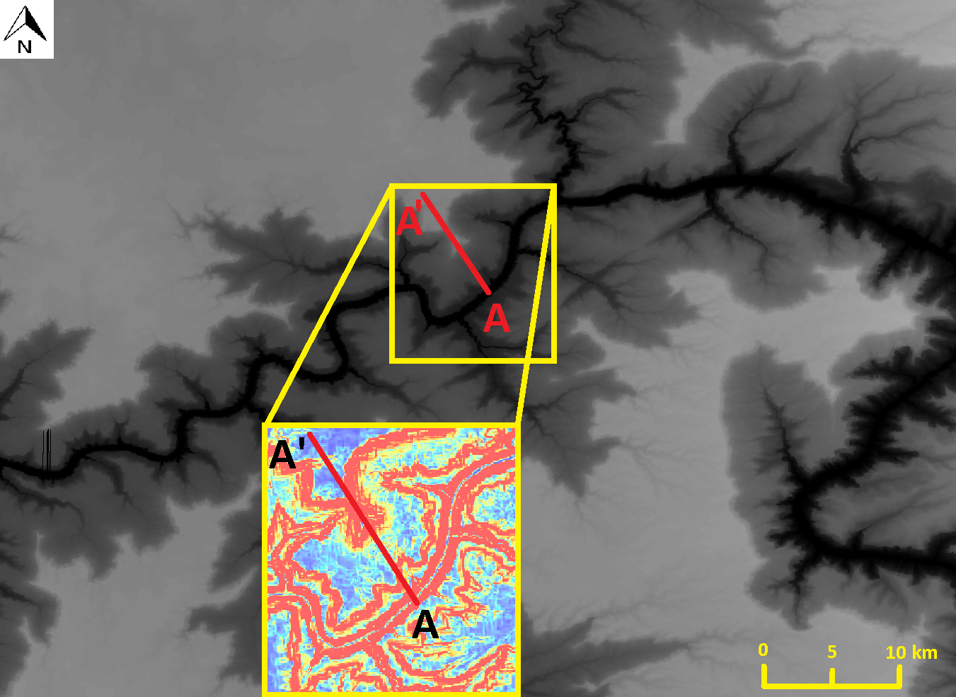
ArcMAP- Remote Analysis
Use Digital Elevation Model (DEM) from USGS website.
Convert to Slope Map
Goal- Find slope along transect
  No side canyons

Slide 7
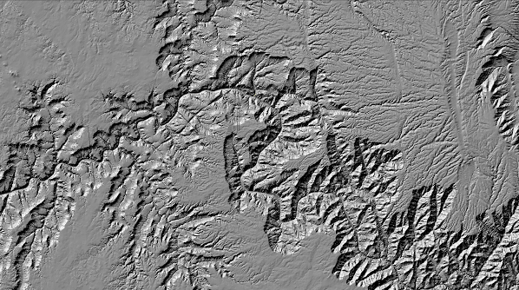
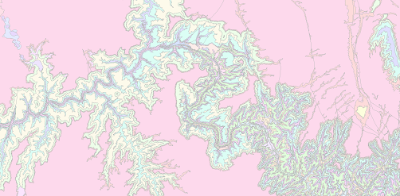
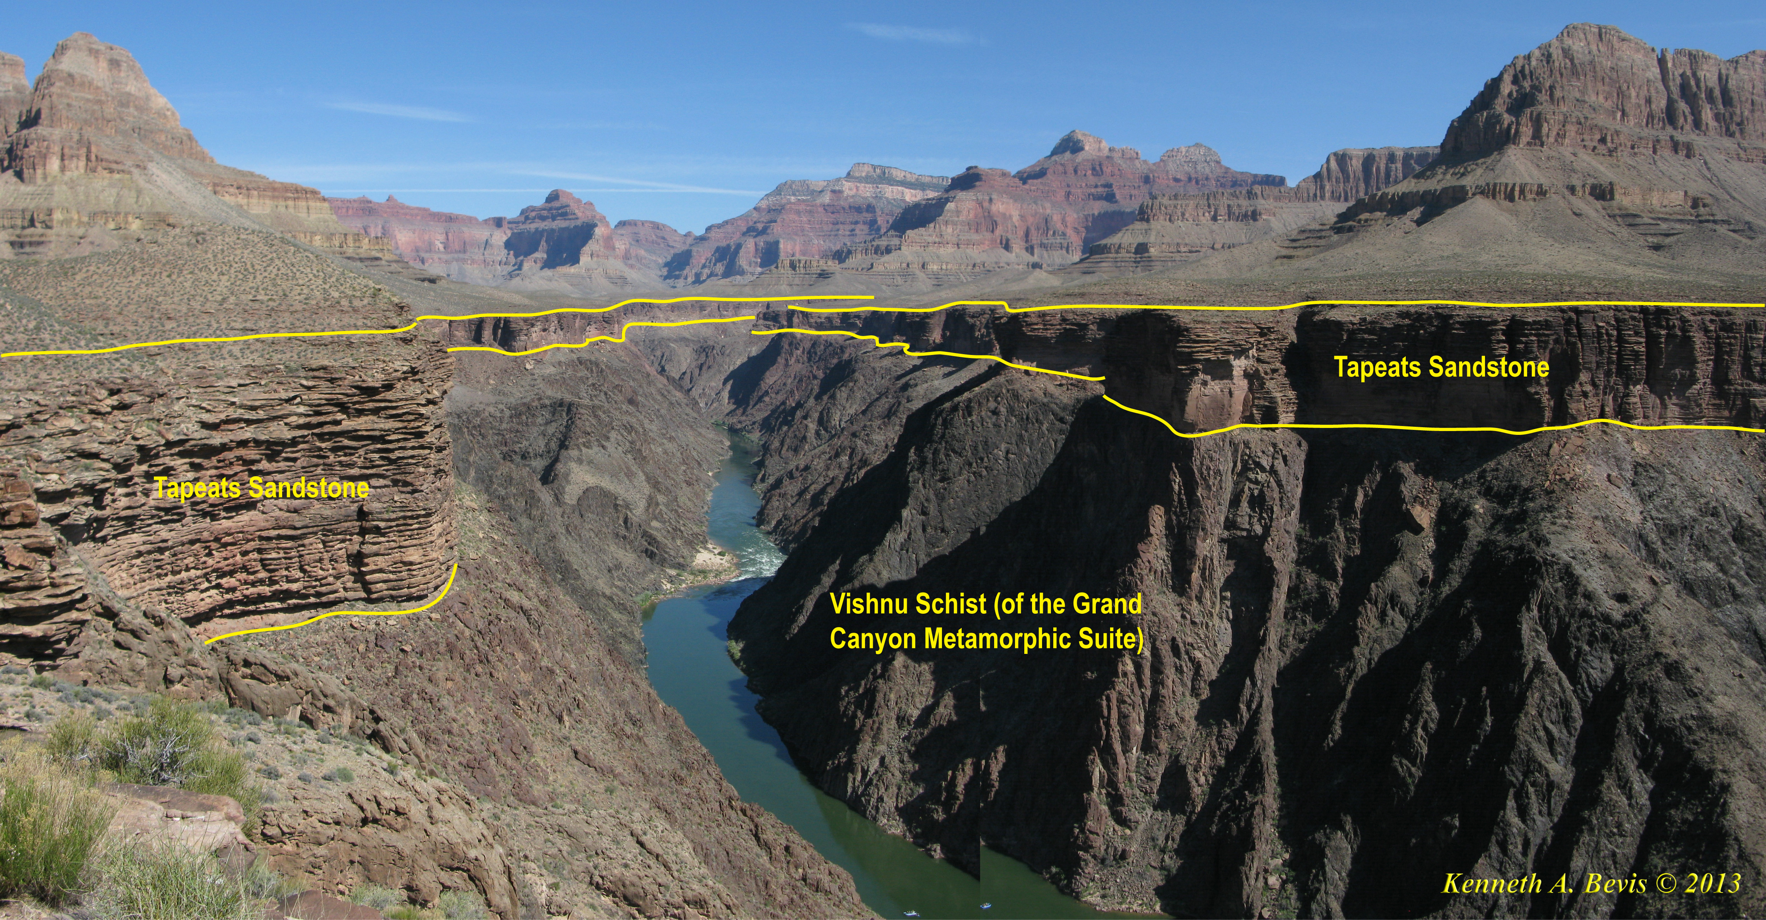
Also make hillshade map (left).
Download Geological Units map from USGS.
Utilize real images to see layer thickness
Superimpose maps onto each other to see details.
Picture Courtesy of the playgroundofgiants.com

Slide 8
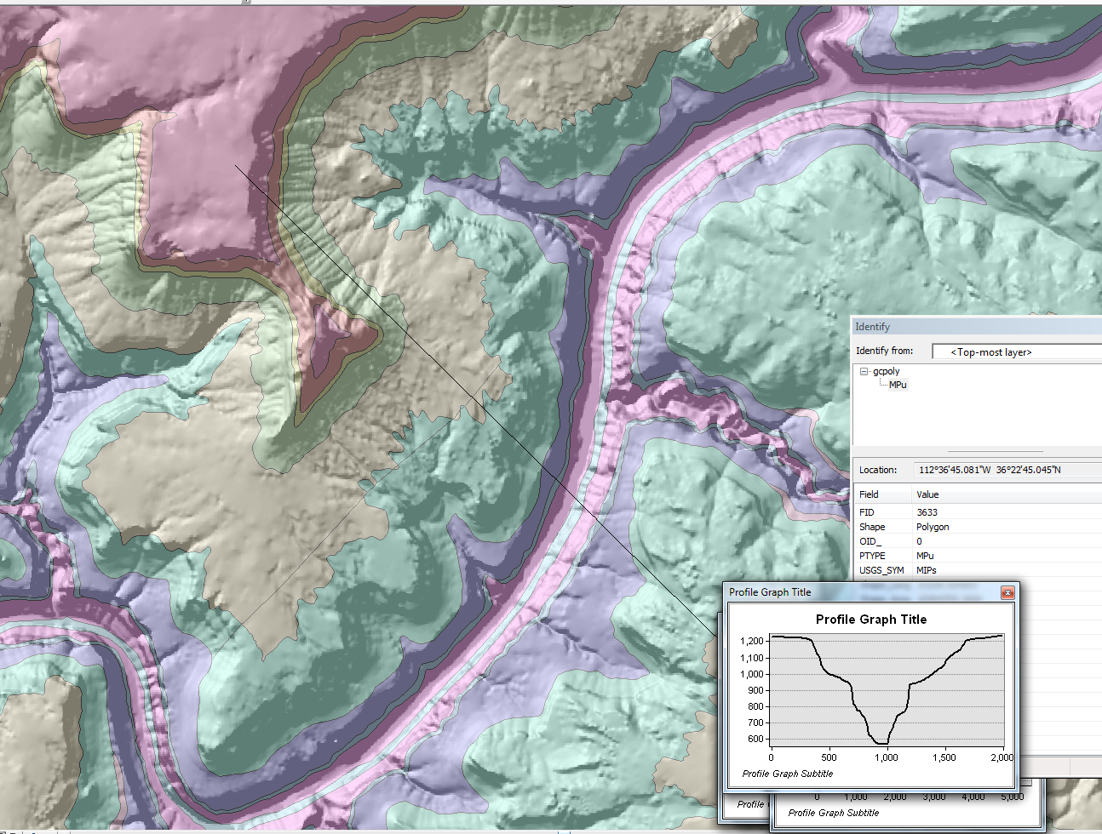
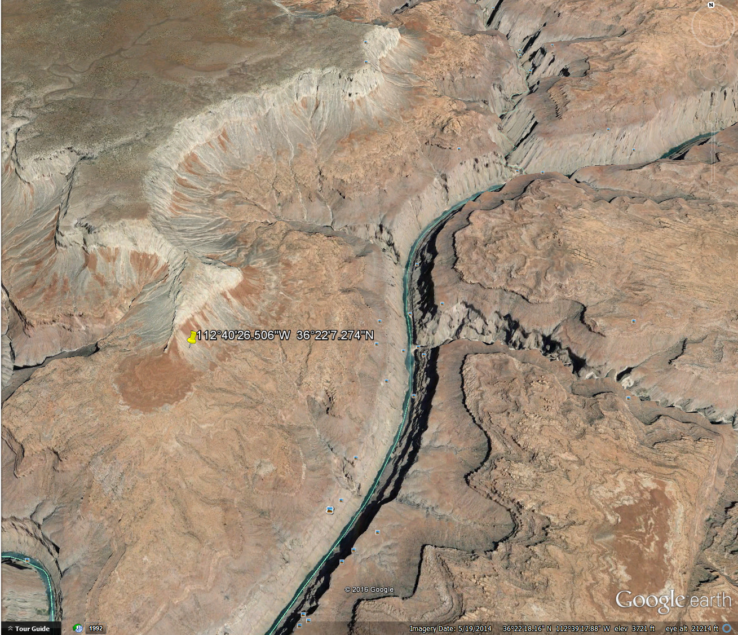
ArcMAP & Google Earth
Above Geological Units Map, DEM, Hillshade are superimposed.
  Distance vs Elevation Profile .
  Identify tool to identify unit names.
Compare it to Google Earth topography and visualize features (right).

Slide 9
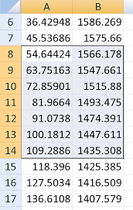
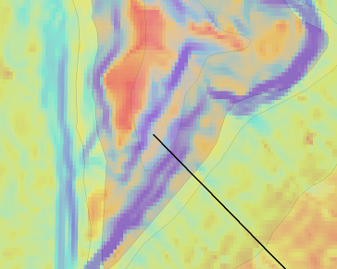
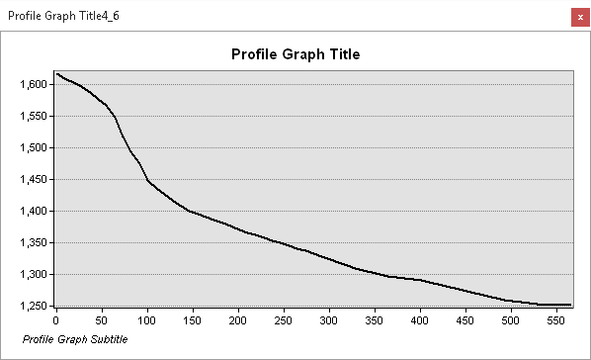
Interpretations
Slope = inverse tan(rise/run).
Geological Units map gives inaccurate slope for cliff former 28.7 degrees.
Compared to 67.3 degrees obtained via new method.

Slide 10
Final Points
Obtained more refined and accurate results utilizing numerous maps to characterize rock units.
Will continue performing this process for many transect lines along Grand Canyon to get representative slopes.
Graph slope values vs rock strengths from P-wave study to see correlations.
  Linear or concave.

Slide 11
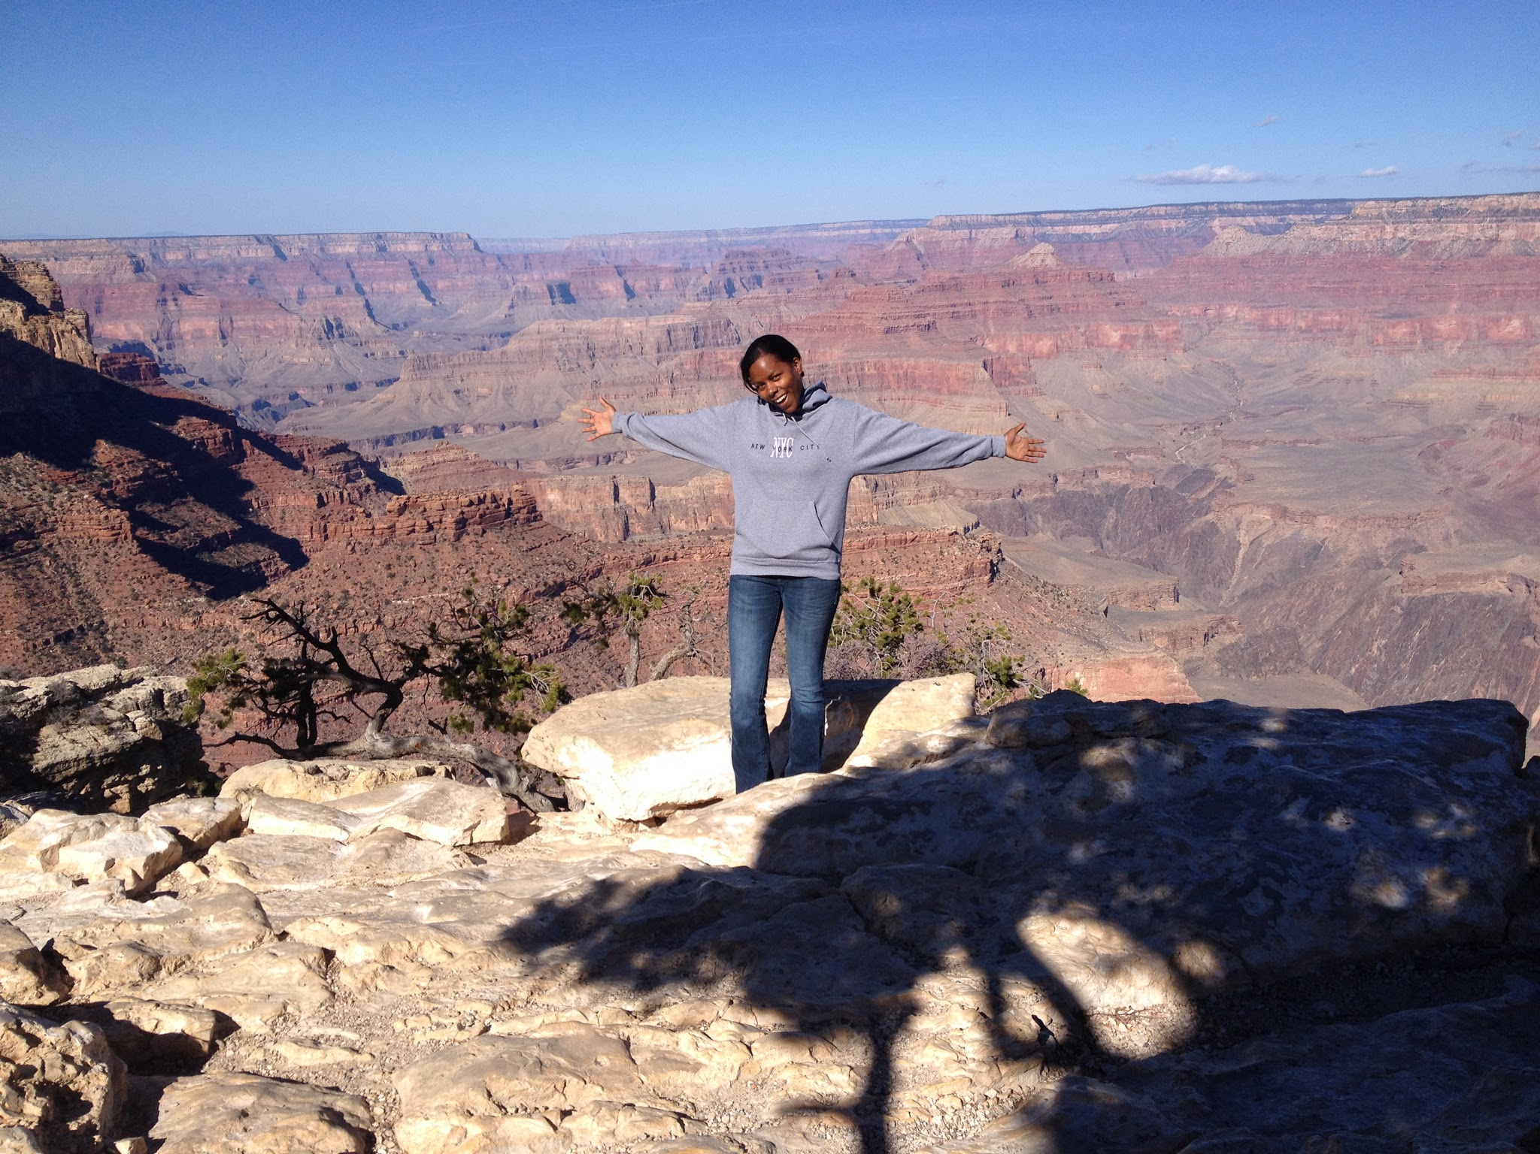
Thank you
Dr. Kelin Whipple
Andrew Darling
Dr. Brian Clarke
ASU/NASA Space
Grant

